Slide 1

Welcome to iHEAD 2025
9-10 September, São Paulo, Brazil

Slide 2

iHEAD 2025 Organising Committee
Chair: Patricia Pozo-Rosich, Spain
Vice Chairs Members
Todd Schwedt, USA Rami Burstein, USA, IHS President
Mario Peres, Brazil, IHS President-elect
Cristina Tassorelli, Italy, IHS Past-President
Irene de Boer, Netherlands, IHS Juniors Group Chair
Henrik Schytz, Denmark, IHS Education Committee Chair

Slide 3
iHEAD 2025 Faculty
Patricia Pozo-Rosich, Spain Mi Ji Lee, Korea
Fayyaz Ahmed, UK Marcio Nattan Souza, Brazil
Sait Ashina, USA Aynur Özge, Türkiye
Rami Burstein, USA Mario Peres, Brazil
Edoardo Caronna, Spain Simona Sacco, Italy
Irene de Boer, Netherlands Todd Schwedt, USA
Gregory Dussor, USA Henrik Schytz, Denmark
Peter Goadsby, UK Cristina Tassorelli, Italy

Slide 4




iHEAD in numbers
108
16
2
DELEGATES
FACULTY
DAYS
45
PROFESORES IESE
COUNTRIES

Slide 5
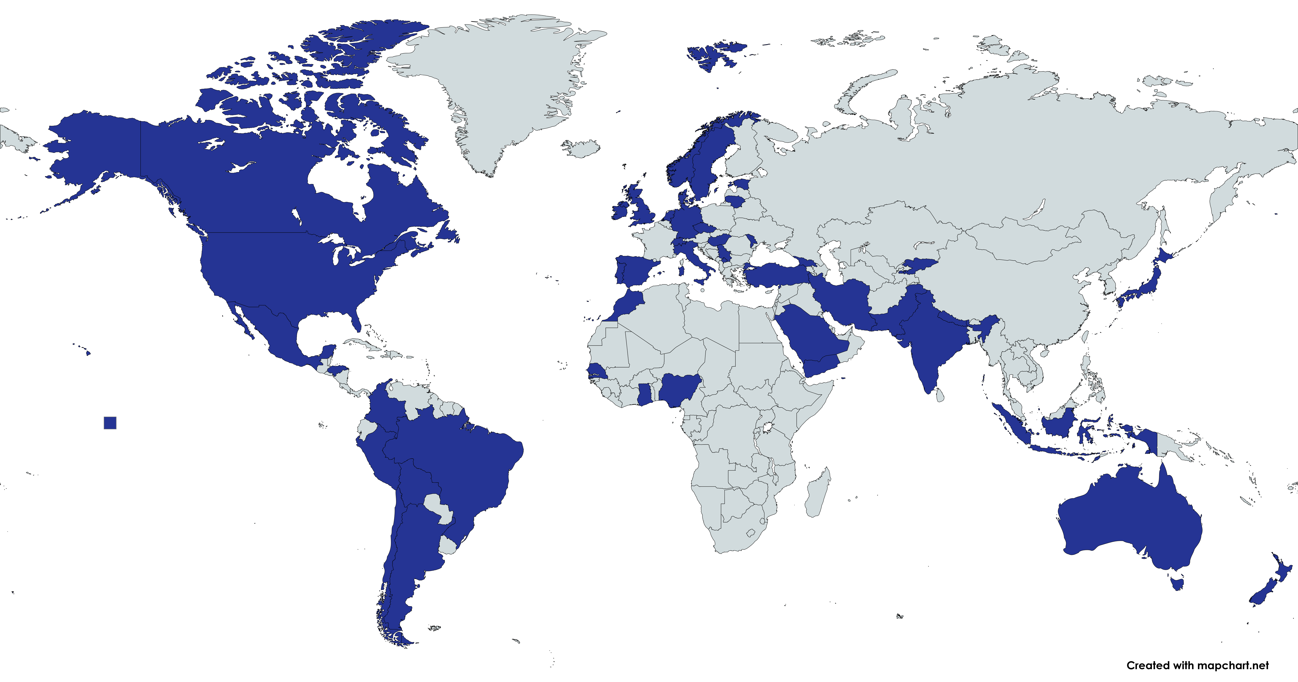
iHEAD delegates 2025

Slide 6
iHEAD – IHS International Headache Academy
iHEAD is an educational 1.5-day pre-congress course offered to IHS members, linked to the International Headache Society Congresses (both IHC and RHC), with a hands-on, active participation programme
Mission
Educate juniors on headache, creating a network which will help grow the young headache community and help increase the quality of clinical care and science
Vision
To do this in the context of congresses to attract young people and their talent/interest to our meetings, incentivising participation.

Slide 7
iHEAD history
1st iHEAD, Copenhagen, Denmark, April 2012
2nd iHEAD, Leiden, Netherlands, October 2014 – 63 delegates from 22 countries
3rd iHEAD, London, UK, October 2016 – 85 delegates from 28 countries
4th iHEAD, Vancouver, Canada, September 2017 – 81 delegates from 20 countries
5th iHEAD, London, UK, September 2018 – 60 delegates from 16 countries
6th iHEAD, Dublin, Ireland, September 2019 – 110 delegates from 28 countries
7th iHEAD, London, UK, September 2022 – 75 delegates from 26 countries
8th iHEAD, Seoul, Korea, September 2023 – 93 delegates from 30 countries
9th iHEAD, Berlin, Germany, May 2024 – 59 delegates from 30 countries

Slide 8
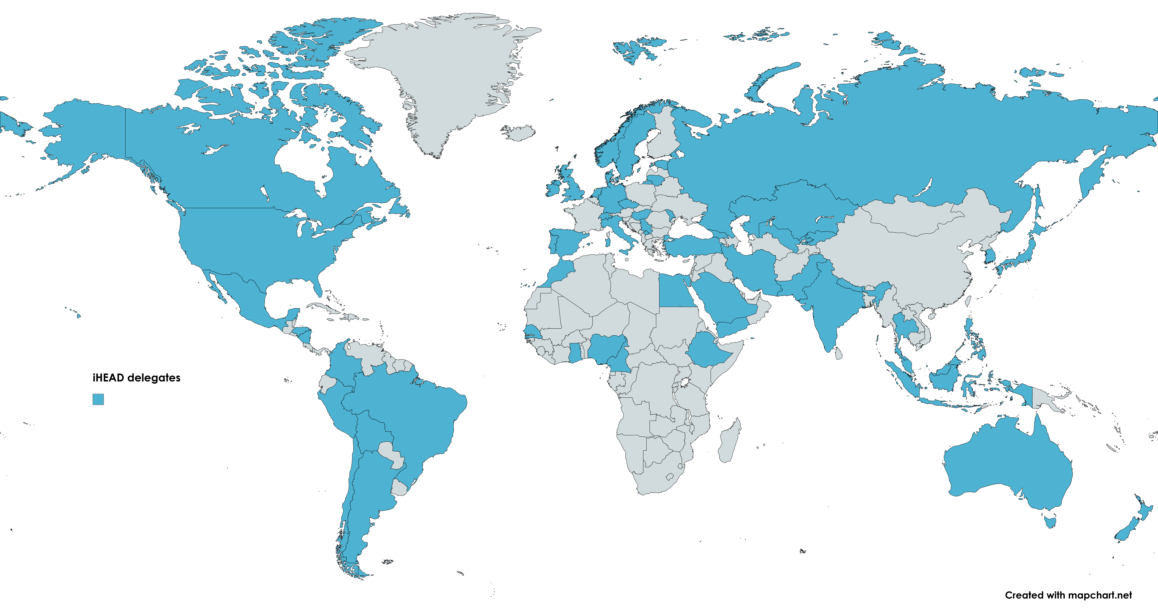
iHEAD delegates since first Academy in 2014
542 delegates
69 countries
all continents

Slide 9
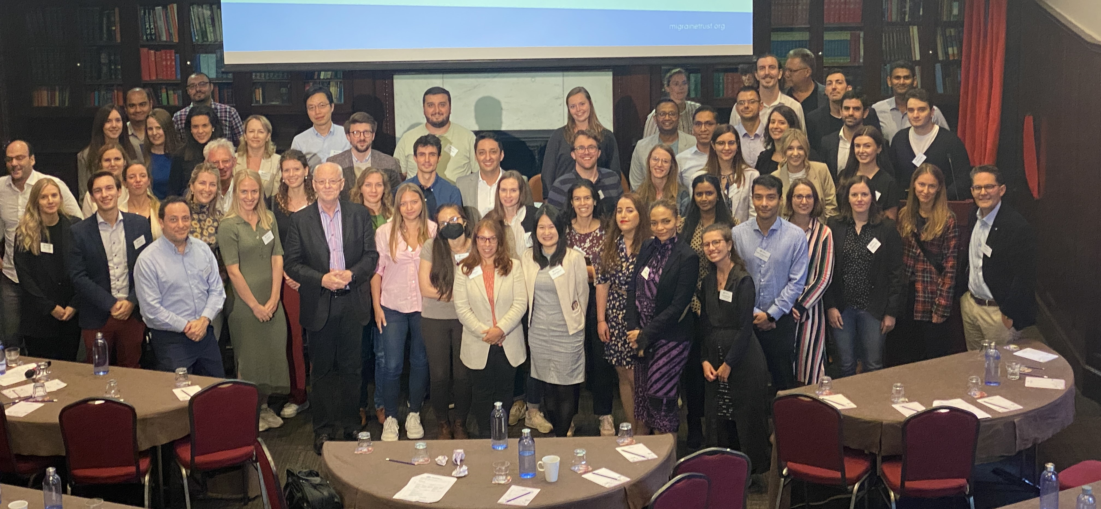
iHEAD 2022

Slide 10
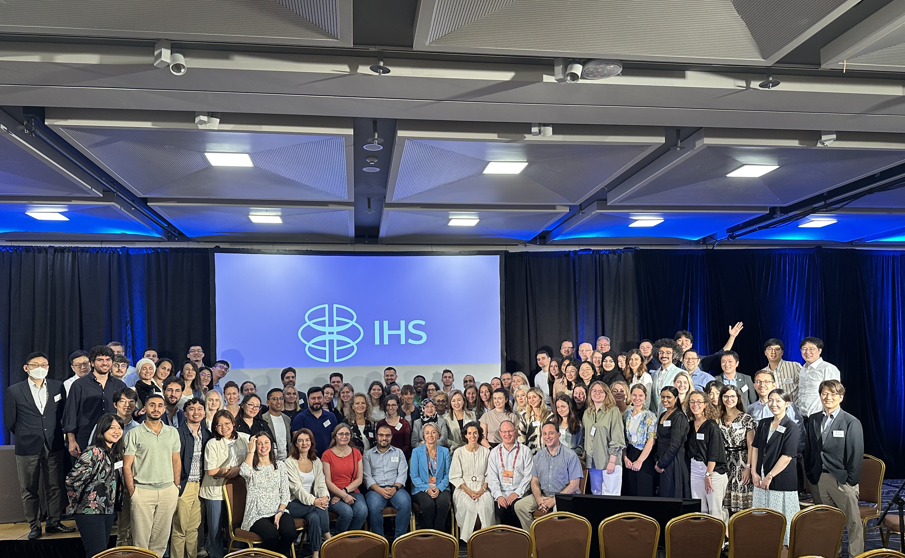
iHEAD 2023 Seoul

Slide 11
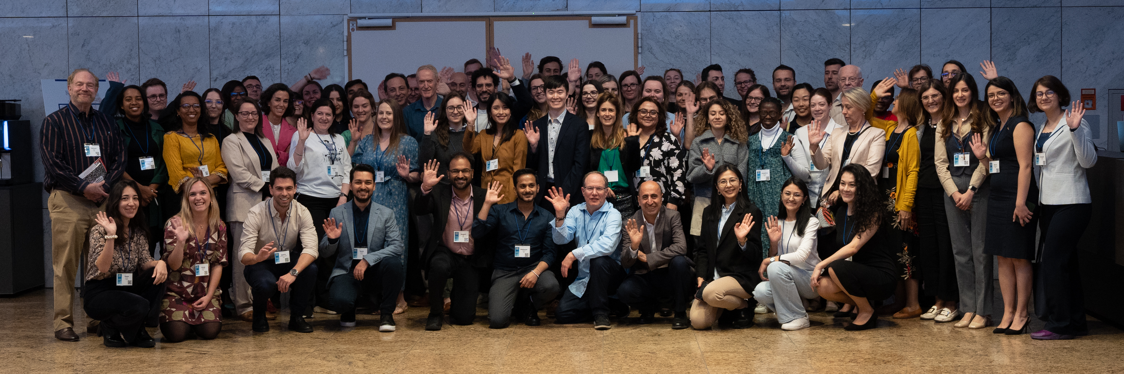
iHEAD 2023 Seoul

Slide 12
Objectives
To learn and exchange knowledge about headache with world-experts
To acquire valuable clinical, scientific and “non-cognitive” skills
To start building an international collaborative network
To work together and participate in a review paper
Gallardo VJ

Slide 13

Focusing on both Clinicians & Scientists

Slide 14


Slide 15


Slide 16


Slide 17
4Cs: Connect, Collaborate, Cooperate & Communicate
Connect
Collaborate
Cooperate
Communicate

Slide 18
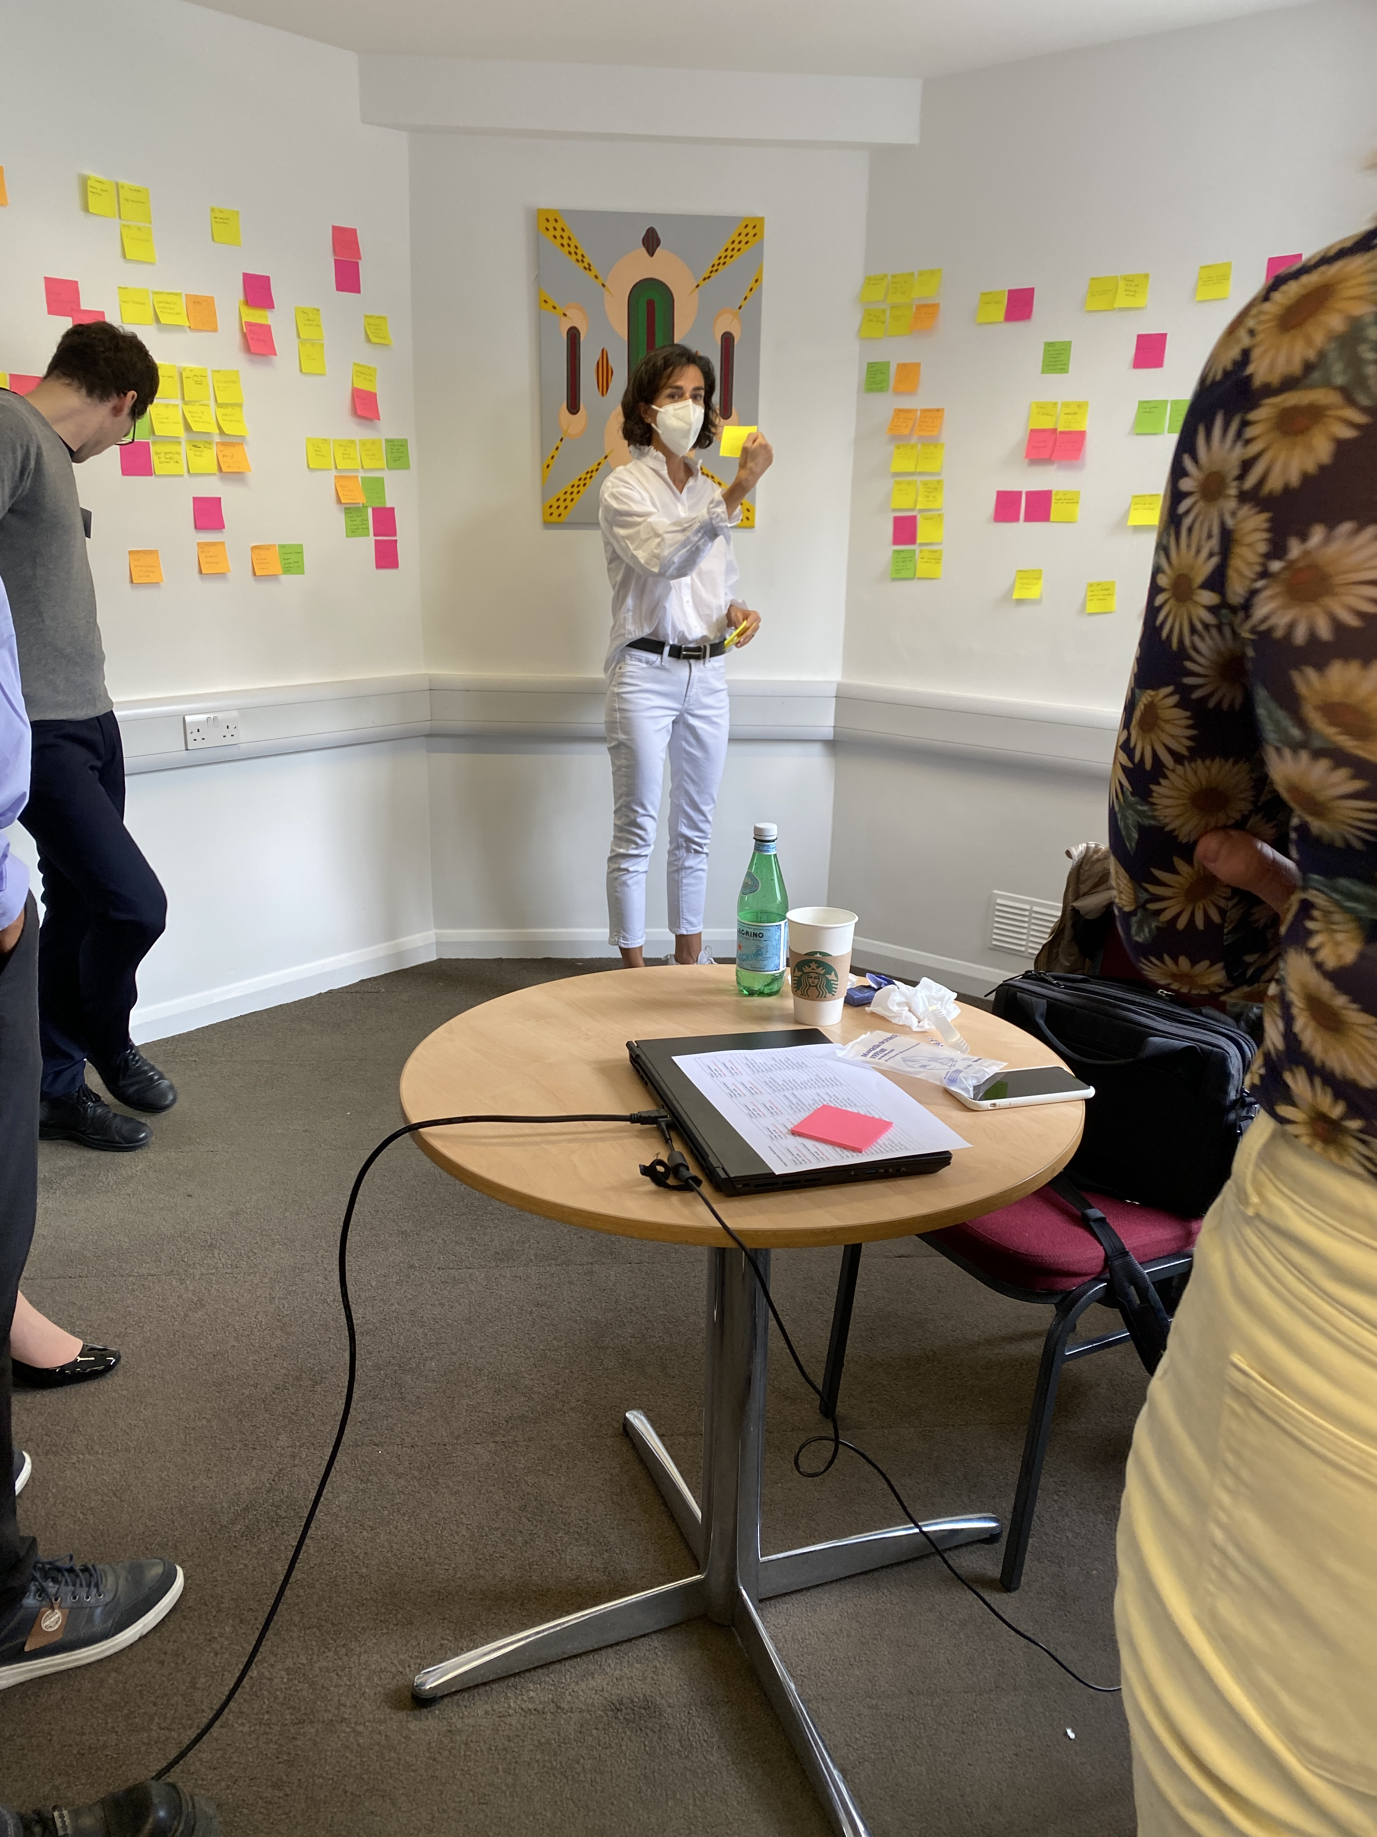
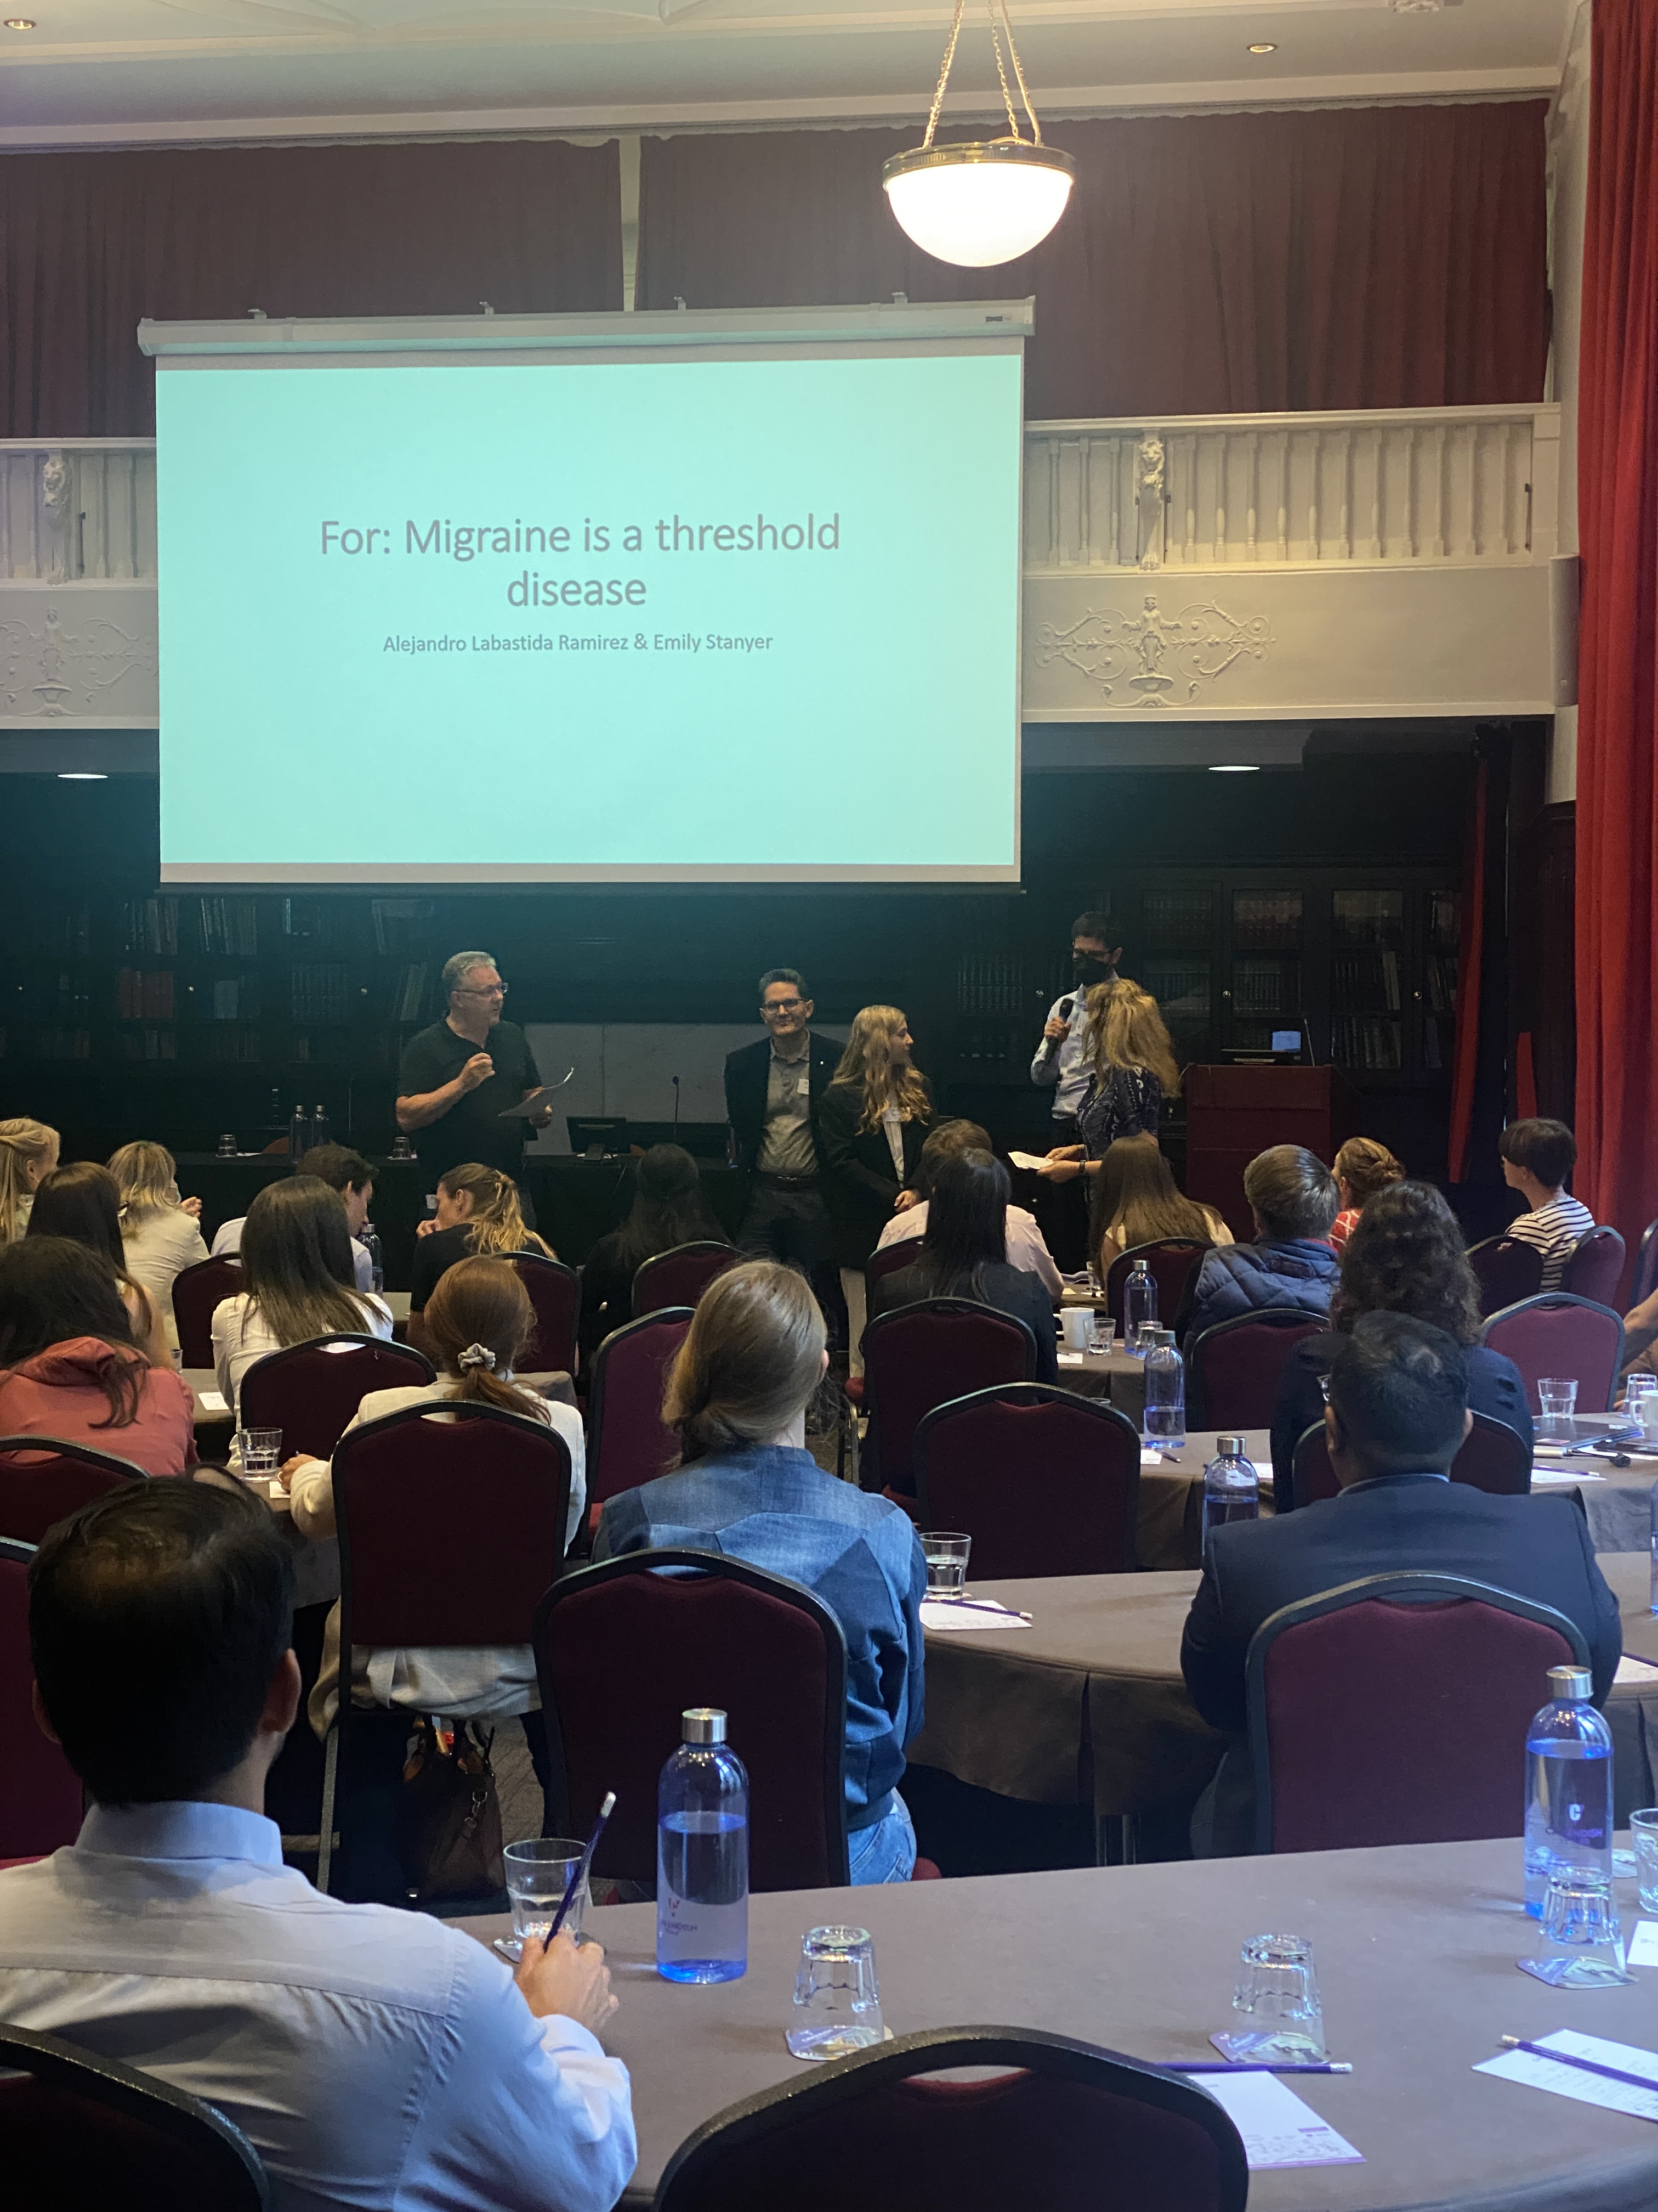
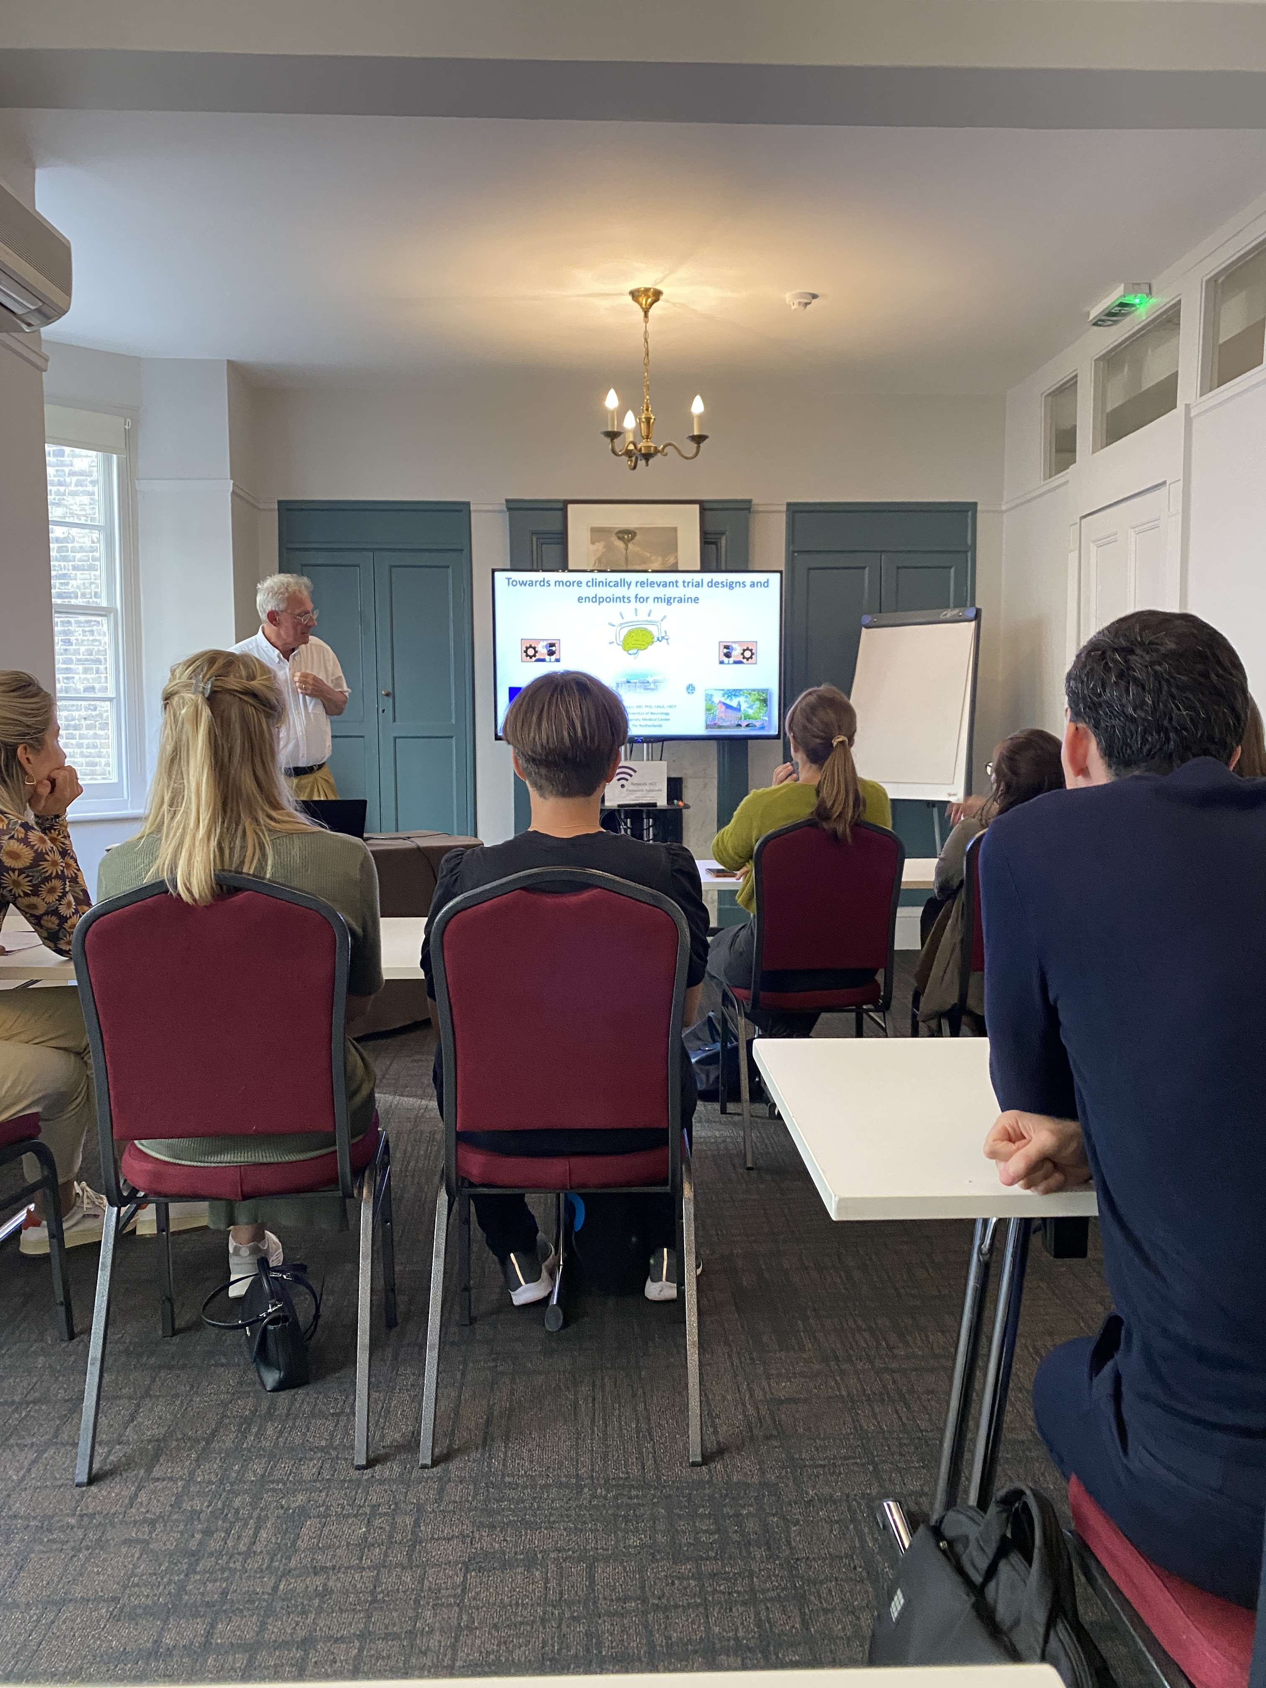
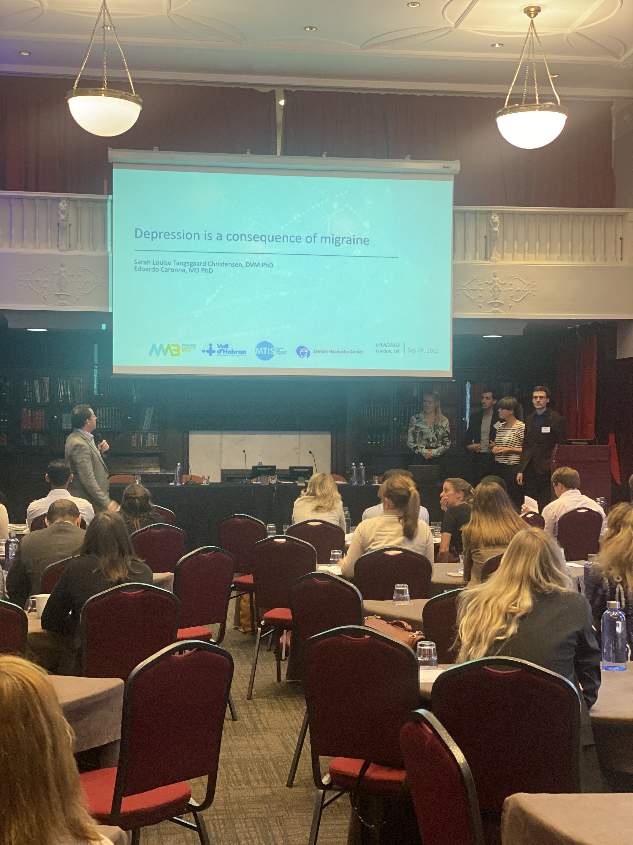
iHEAD 2022

Slide 19
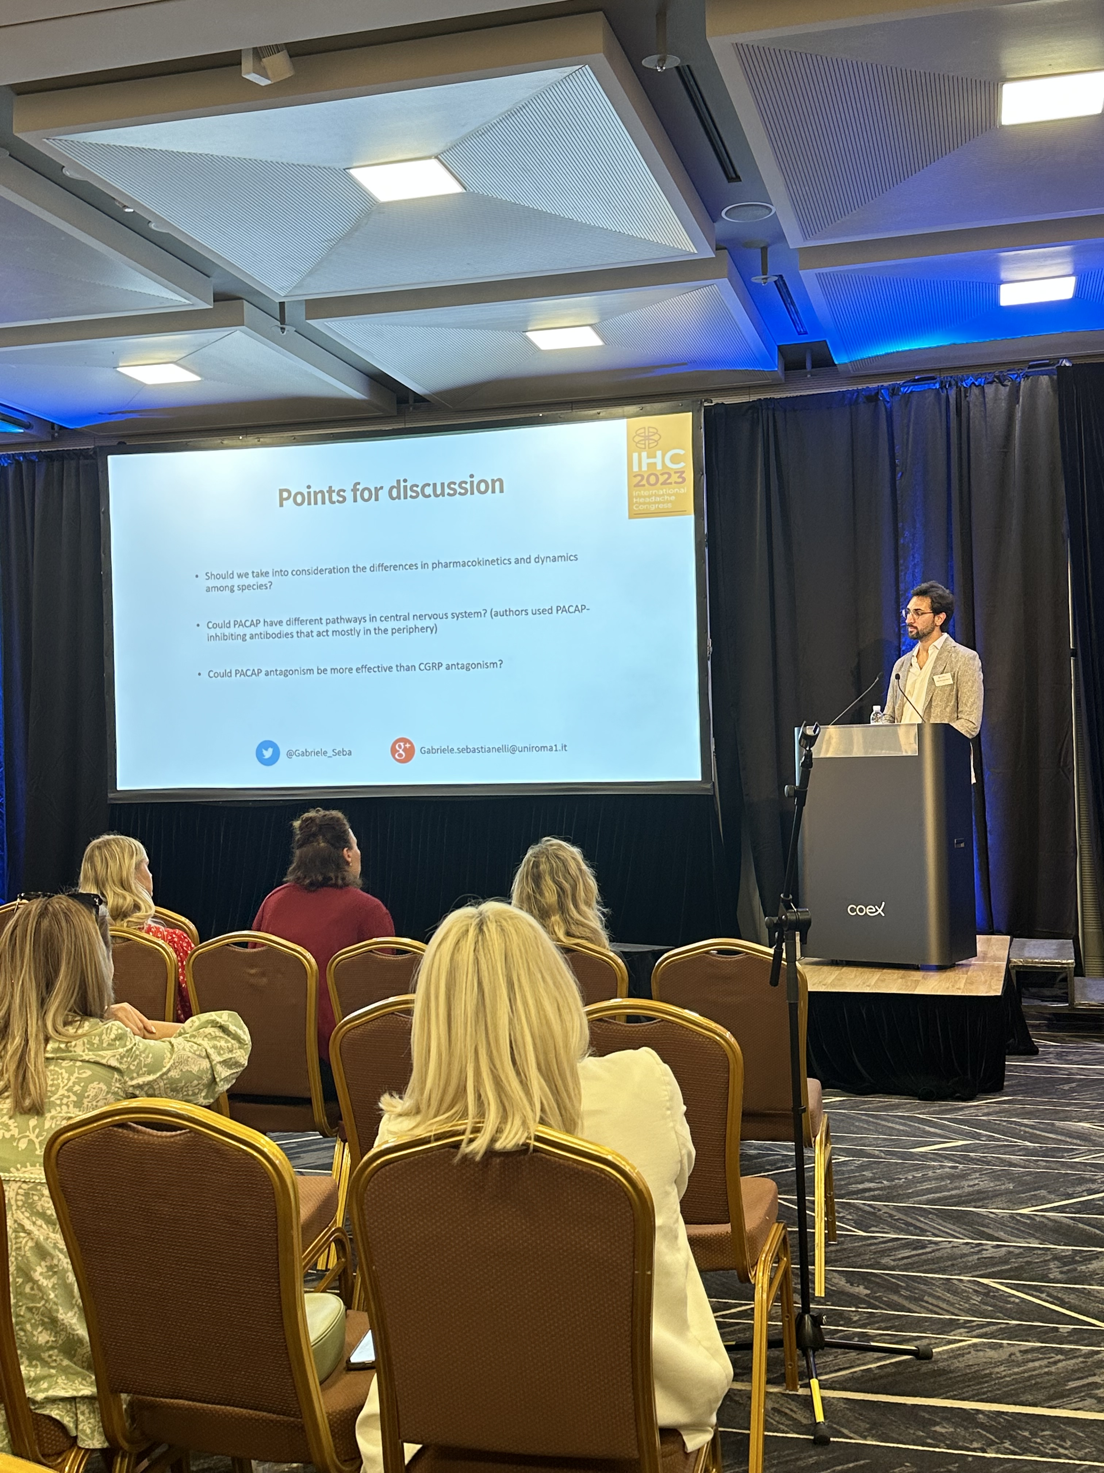
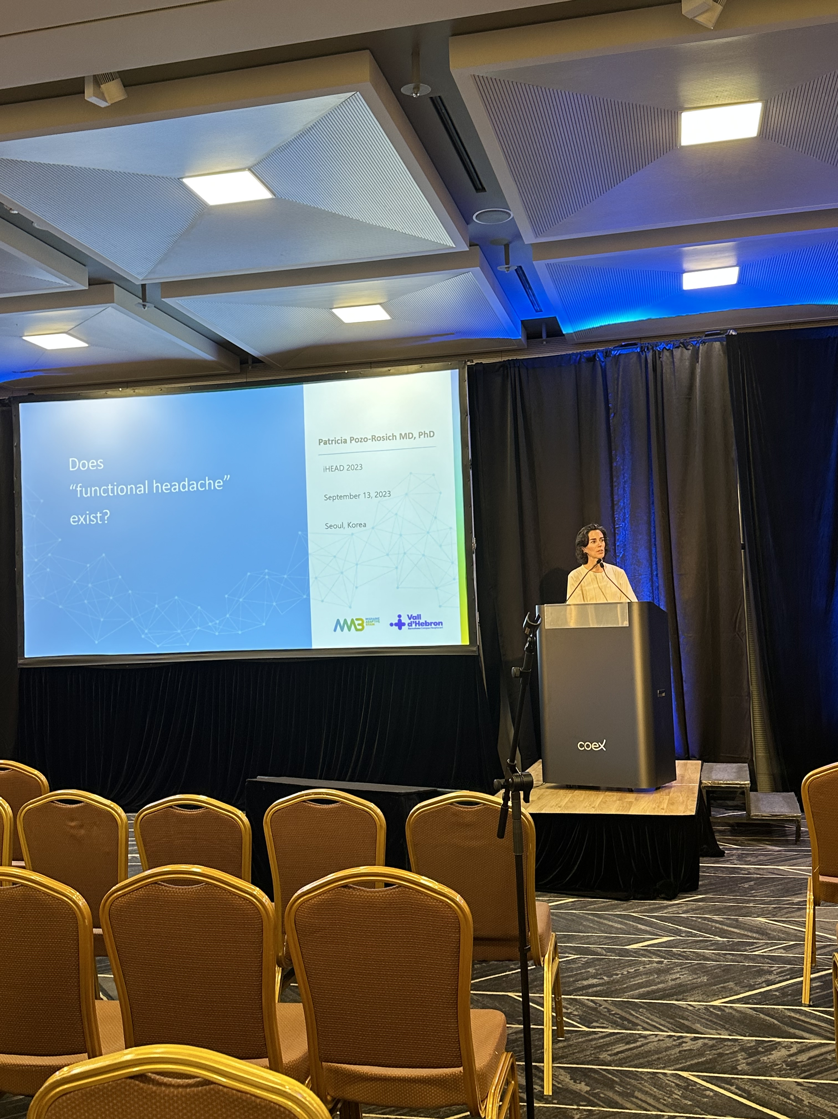
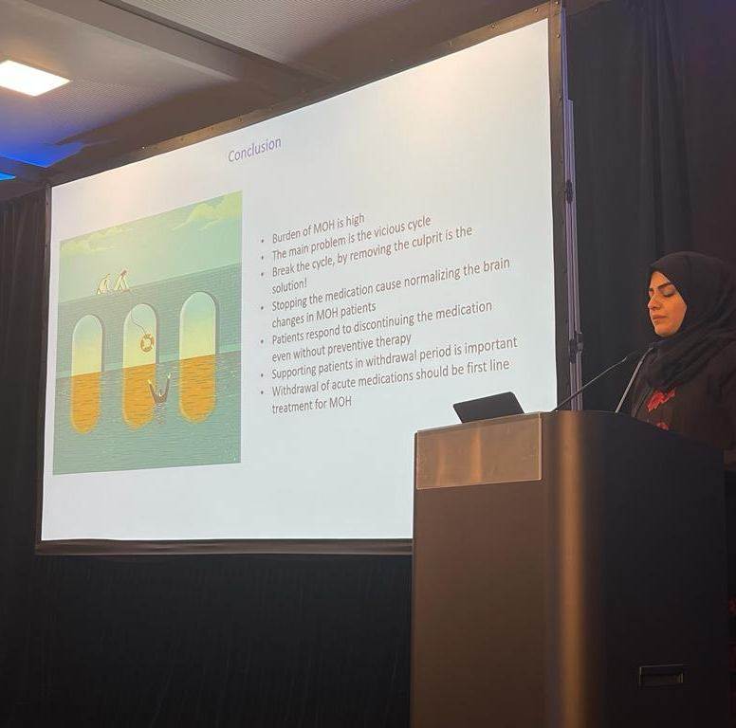
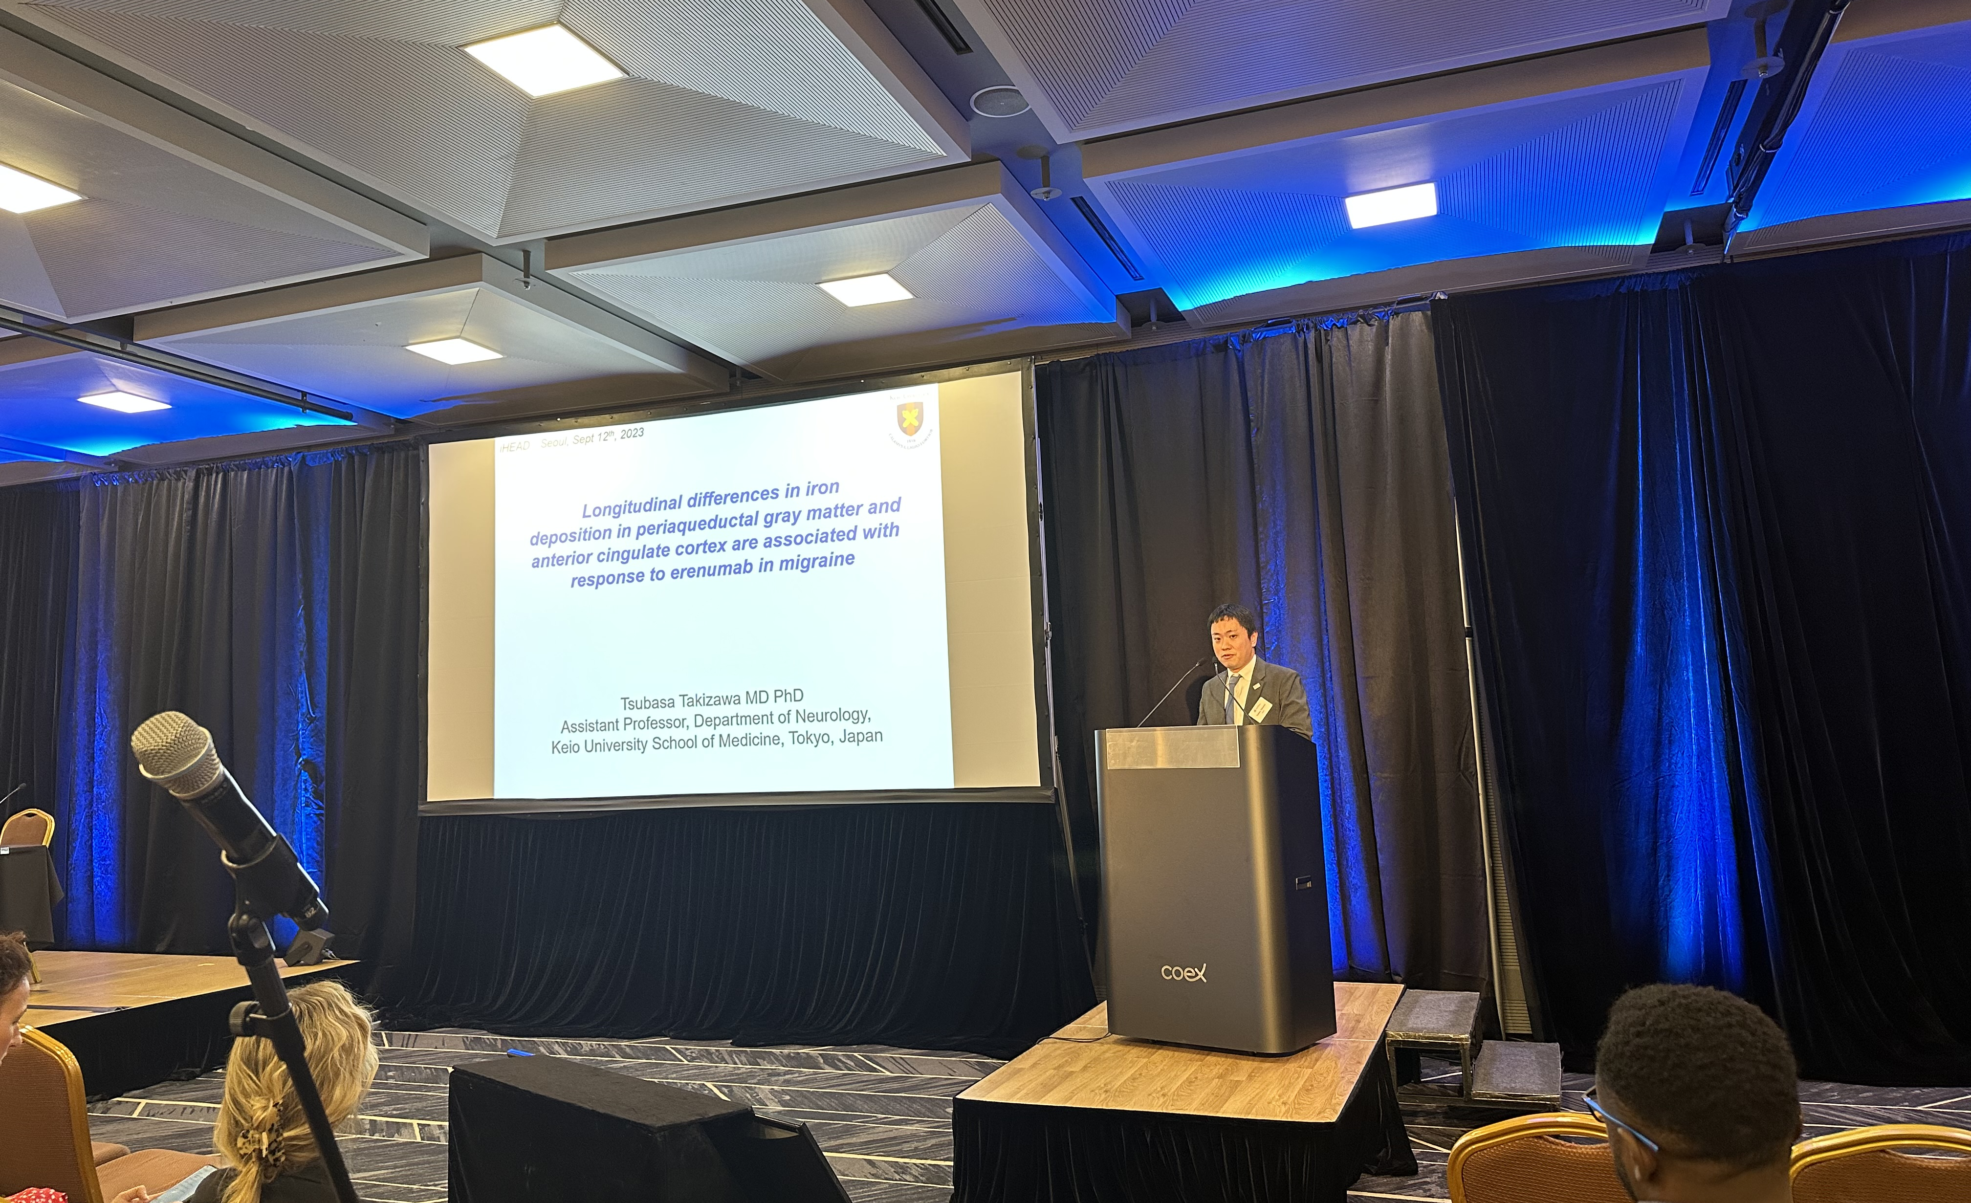
iHEAD 2023 Seoul

Slide 20
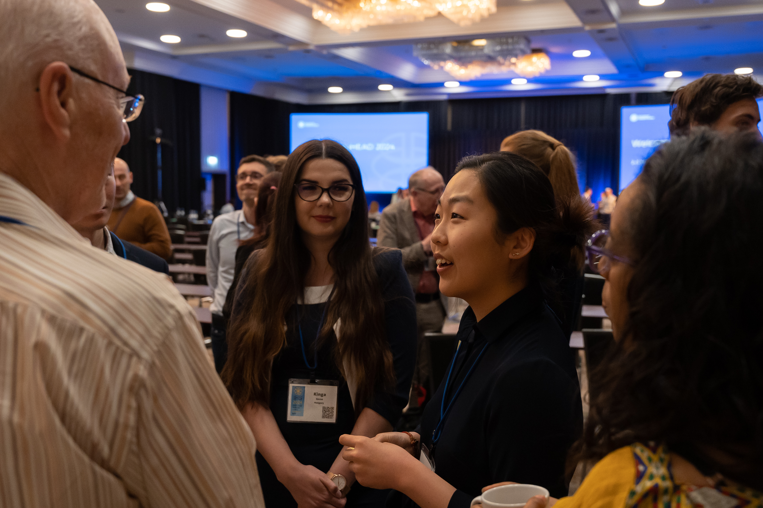
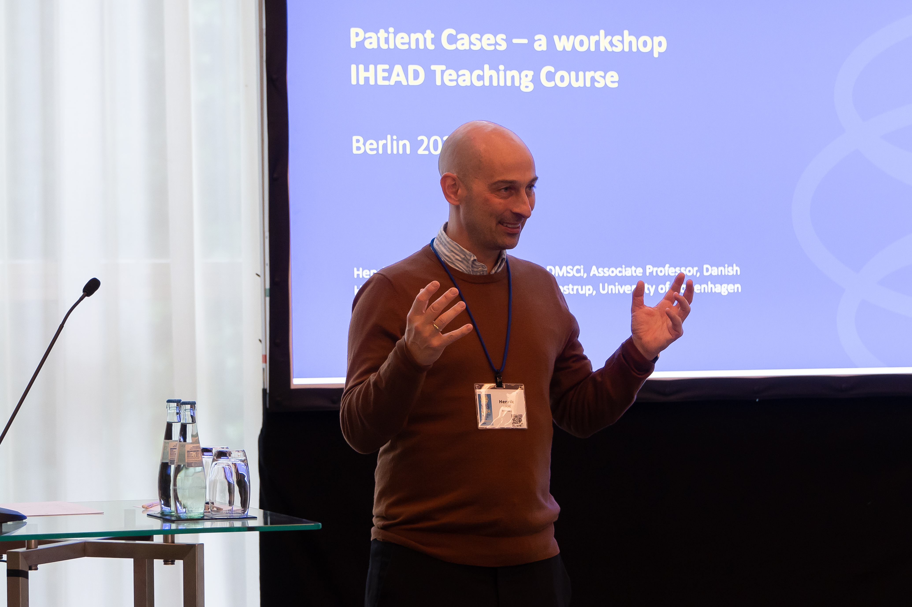
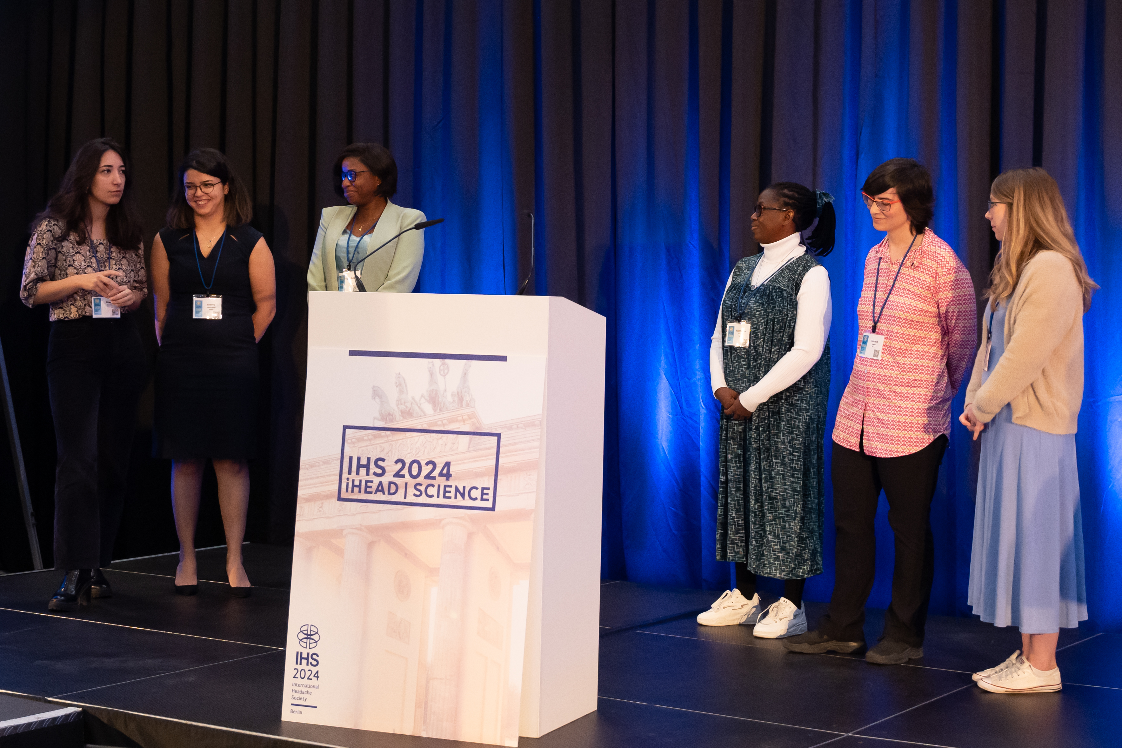
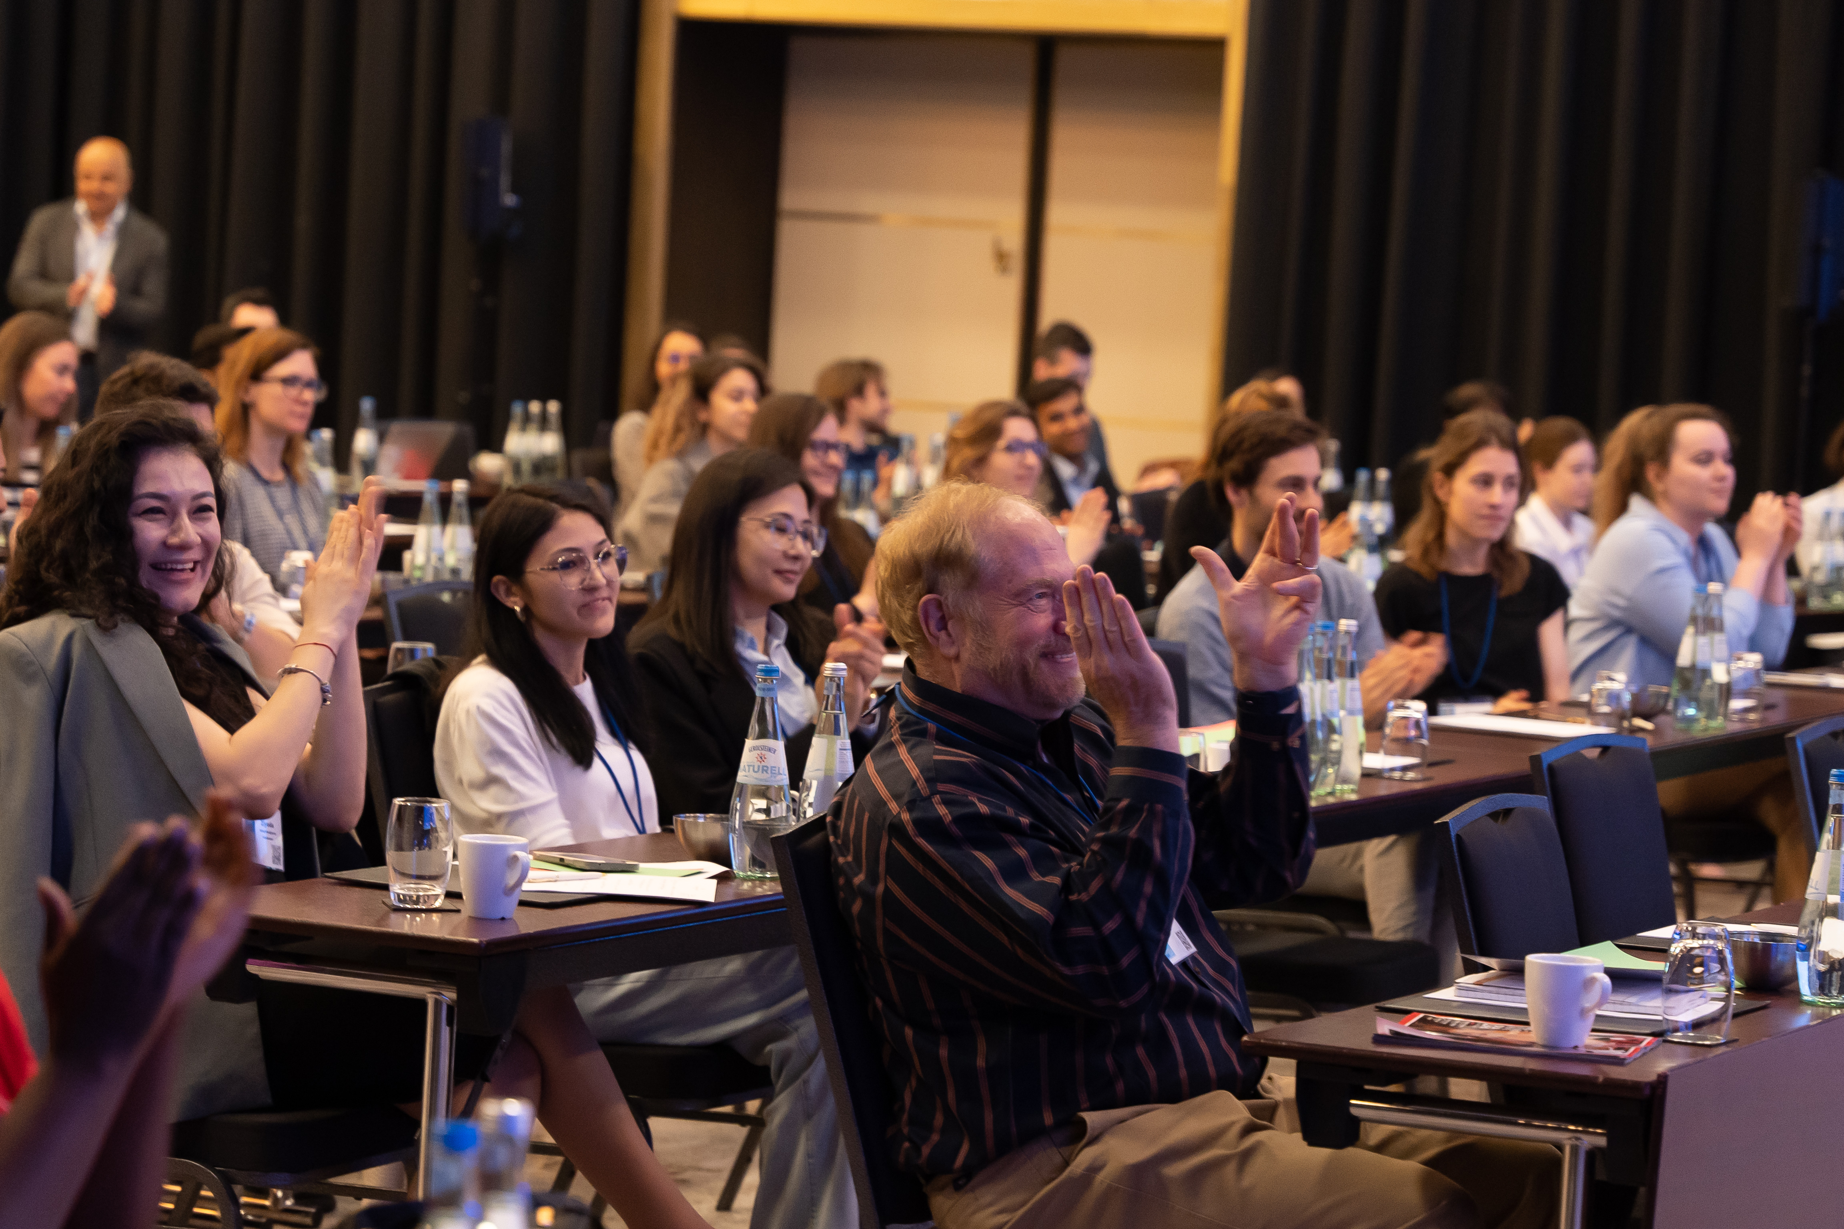
iHEAD 2024
Berlin
iHEAD 2024 Berlin

Slide 21
Teachers, Mentors …

Slide 22
Remember to build
bridges, alliances & friends

Slide 23
Requirements
X = ( K + A ) x A
    The capacity to learn is a gift;
    the ability to learn is a skill;
    the willingness to learn is a choice

Slide 25
Tuesday 9 September
09:30 The iHEAD programme (for the new and the experienced) – Patricia Pozo-Rosich
10:00 Lectures: Present and future of headache
International Classification Headache Disorders: the road towards the 4th Classification – Peter Goadsby
Headache Research Priorities: an action plan – Todd Schwedt
11:00 Break
11:30 Hands on: Secondary headache cases with patients from Albert Einstein Hospital
13:00 Lunch

Slide 26
Tuesday 9 September
13:40 Group photo
14:00 Interactive workshops 1
15:25 Break
15:50 Interactive workshops 2
17:30 Common mistakes in headache research – Irene de Boer
18:30 Transfer to dinner
19:30 Dinner

Slide 27
Wednesday 10 September
08:00 Headache Clinical Care
Can we avoid chronic migraine? – Patricia Pozo-Rosich
Tips & tricks on how to organize your clinic & manage your patients: a global perspective – MiJi Lee, Aynur Özge, Sait Ashina, Fayyaz Ahmed
09:30 Break
10:00 Debates
Debate 1: Is cluster headache easy to manage?
Debate 2: Should we follow the IHS practice recommendations
11:30 Best headache papers and why
12:30 Challenges & opportunities of developing a career in headache – Edoardo Caronna and Irene de Boer
12:45 Close
13.00 Transfers to World Trade Center

Slide 28
